Slide 1
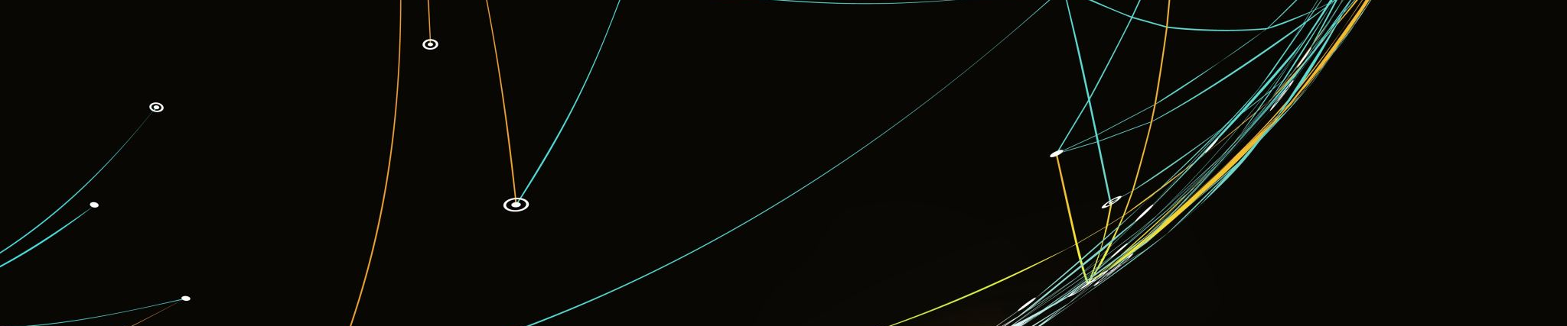
Python for Data Analysis
DIA3 || Nicolas MICHALSKI || Guillaume LAURENT
Dataset for estimation of obesity levels based on eating habits and physical condition in individuals from Colombia, Peru and Mexico

Slide 2
Dataset Presentation
DIA3 || Nicolas MICHALSKI || Guillaume LAURENT
Our dataset is about the estimation of obesity levels in individuals from the countries of Mexico, Peru and Colombia, based on their eating habits and physical condition. The data contains 17 attributes and 2111 records, which are labelled with the class variable NObesity (obesity level), that allows classification of the data using the values of insufficient weight, normal weight, overweight level 1 and 2, obesity types 1, 2 and 3.
77% of the data was generated synthetically using the Weka tool and the SMOTE filter, 23% of the data was collected directly from users through a web platform.
https://www.sciencedirect.com/science/article/pii/S2352340919306985?via%3Dihub
Keywords:
Obesity, Data mining, Weka, SMOTE
Timeframe : May 2019
Database Authors : Fabio Mendoza Palechor, Alexis de la Hoz Manotas

Slide 3
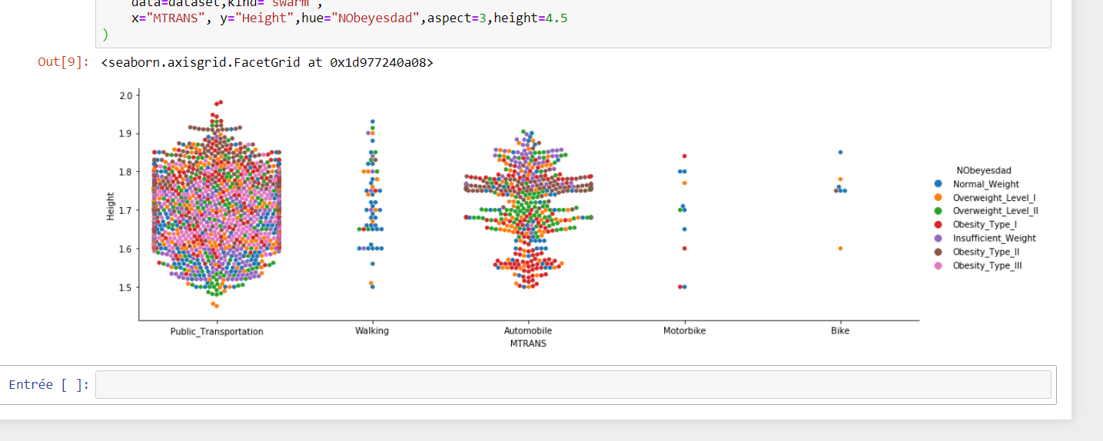
Change of the attribut MTRANS
Numerical values where needed to have a better view of the dataset, we use reschear on the physical activity of walk to create a attribut to show if people do the daily activity of 30min/day that result in being more often healthy
https://www.researchgate.net/publication/277771531_Transport_Physical_Activity_and_Health_Present_knowledge_and_the_way_ahead

Slide 4
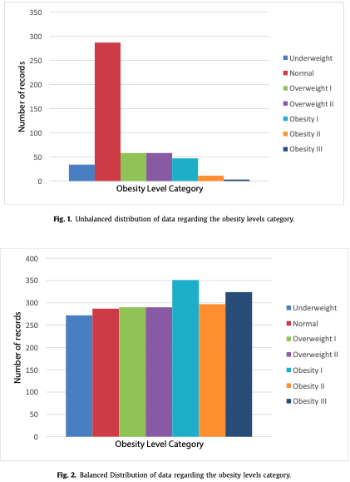
An eye on the data : Before and after balancing
As we can see from the data, most people who took the survey (upper graph) are situated in the « Normal » category. Therefore, the Smote tool was used to generate enough results for the other category levels.
As a result, some correlations might end up being due to an effect of mass, since the generator algorithm is likely to be influenced a lot by the few results it has to work with, when generating new elements for a specific obesity level.
This model gives us more data to work with, but we also don’t know what are the criteria used for creating these samples of Overweight, Obese and Underweight individuals.

Slide 5
Some basic statistics …
DIA3 || Nicolas MICHALSKI || Guillaume LAURENT

Slide 6
Obesity level is processed using the following formula :
Weight / Height ²
So it makes a lot of sense that weight increases linearly with Obesity Level.
When it comes to height, the average is globally the same, the smallest people seem to be in the normal type but the other Obesity levels are possibly ”faked” by the model since very few individuals had influence on them (most notably Obesity Level 2).
Overall the Obesity level formula was created so that Height is compensated by Weight so it’s normal that all categories AVG is somehow similar

Slide 7
This is where the model is the less relevant, only 2 persons in the OBS2 category (among thousands) are women when almost all OBS3 group members are.
For the other categories, we could say that there’s a large proportion of the Insufficient Weight persons that are women.
This could be due to our social constructs that consider women should weight much less than men.
Logic would say using Technological Devices imply staying home or procrastinating and gaining weight, but this dataset on the other hand tends to show that Obese people tend to use them a little bit more than Normal/Overweight people, but much less than Underweight People.
Slim Nerd has never been as accurate

Slide 8
The lower categories are overall more prone to practice physical activities, however the heavier categories consume more water overall. That’s very weird seen from that angle, since we’ll later see that those 2 variables are very correlated…

Slide 9
When it comes to consumption of Alcohol, we can definitely see the heavier categories destroy all competition.
But when it comes to smoking, the Normal class and Overweight II (but this one might be biased by the model) is much more represented. Weirdly few people who took the survey are smokers, 5% being the highest rate for a category

Slide 10
A very interesting aspect about gaining weight is the social consequences. Nobody wants to be in Overweight or Obesity, for health reasons but also for their personal self confidence and image.
We can observe that as people who are watching out the most for their calories consumption are the Overweight 1 and Normal categories, who fear to climb the Overweight ladder sooner or later …
When it comes to nutrition, both lower and upper category eat the most often, but extremely obese people consume much more. Whether it is high caloric food (sky blue) or vegetables (pink), they overpass every other category of people.
Another interesting fact is that normal weight people consume the least vegetables, another aspect that makes me doubt the data generated or gathered.
We can note that maybe Obese people count the amount of times they eat veggies and have a better awareness, or are lying to themselves in the survey, which would explain why they eat more vegetables than other people…

Slide 11
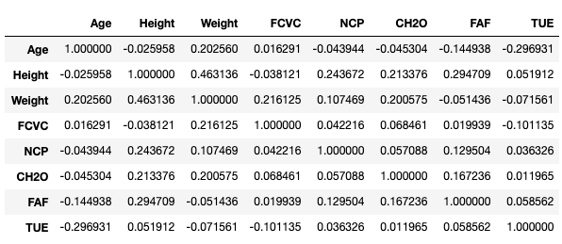
Correlation Table Analysis
DIA3 || Nicolas MICHALSKI || Guillaume LAURENT
Since we had many qualitative variables (Gender, Family history with Overweight, Smoking, Physical activity frequency, Medium of transportation, Number and quality of meals, …) we designed multiple function to convert them to int that correspond to their intrinsic value (1 for yes, 0 for no for instance)
> See the update Correlation Table next
Here is the quantitative values correlation table from our dataset.
We can observe that Height is heavily correlated with Weight (0.463), Number of Meals (0.244), Water Consumption (0.213) and Physical Activity Frequency (0.295).
While Weight is also correlated with Water Consumption (0.201) and Vegetables Consumption (0.216).
That last correlation is quite discutable and could be due to the dataset model (synthetised data)
Age and Usage of Tech (-0.297) are logically very negatively correlated.

Slide 12
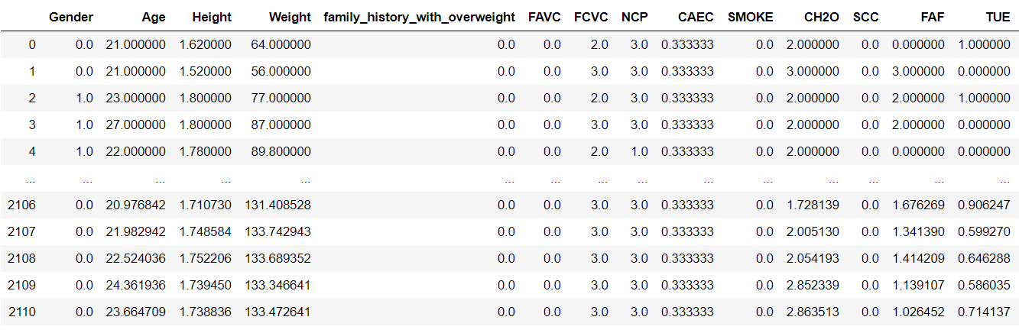
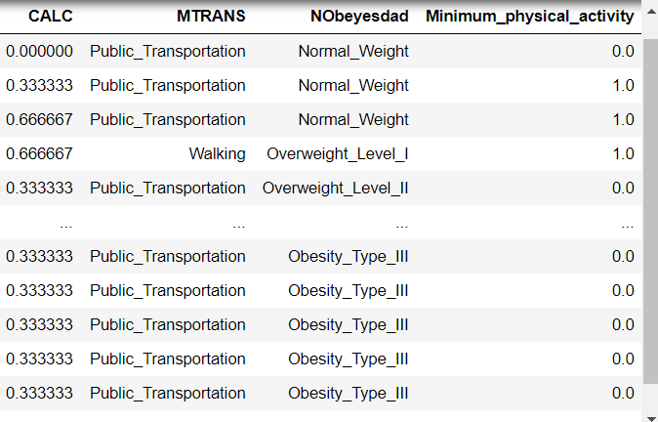
Complete matrix of correlation

Slide 13
ModeliZation
DIA3 || Nicolas MICHALSKI || Guillaume LAURENT

Slide 14
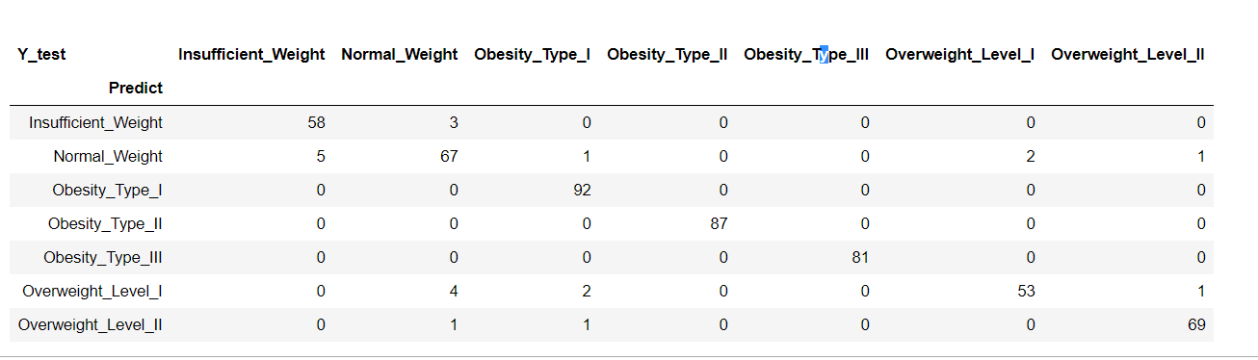
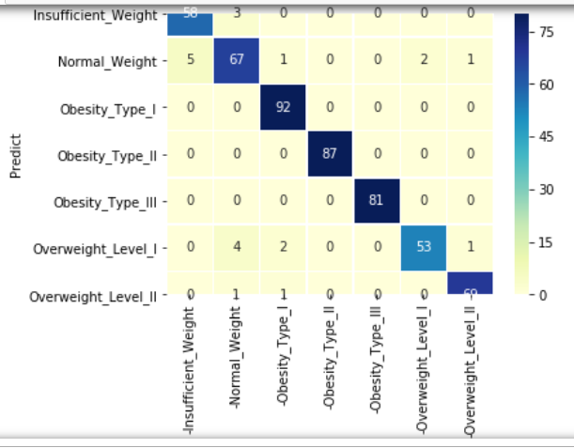
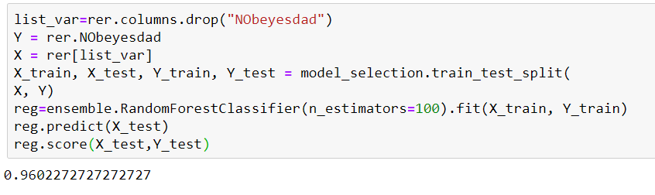
HeatMap prediction of Obesity with RandomForest
The heatmap give the idea of the concentration of the values predicted, we achieve a max of 0.96 as a score with RandomForest

